Slide 1
Turbomachinery
Centrifugal Compressors Design
Prof. P. Gaetani
paolo.gaetani@polimi.it

Slide 2
Input Data
Intercooled compressor for industrial application:
Mass Flow rate: G = 5 Kg/s
Inlet total pressure: P_{T,in} = 1 bar_{A}
Inlet total temperature: T_{T,in} = 20 °C
Outlet total pressure: P_{T,out} = 4 bar_{A}
Averaged adiabatic efficiency: η_{ad} = 0.85
Rotor Blade thickness (in tangential direction): t = 2 mm
Rotor outlet flow angle: α₂ < 70°
Inlet Temperature after inter-cooling: T_{i} = 35°C
Max inlet temperature in the intercooler: T_{m} = 110°C
No pressure loss in the intercooler

Slide 3
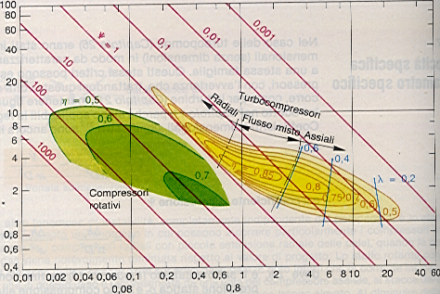
First Guess
Radial / axial

Slide 4

ROTOR
$$\overline{β}=\frac{β_{1}+β_{2}}{2}$$
Blades count
0.4 = constant representative of the optimal solidity
N = approx to the closest integer
All geometrical parameter can now be calculated
SLIP FACTOR
Stanitz: (found for β_{2,g}= 0° ; good approx in β_{2,g} ± 45°)
β_{2,g} = …..

Slide 5
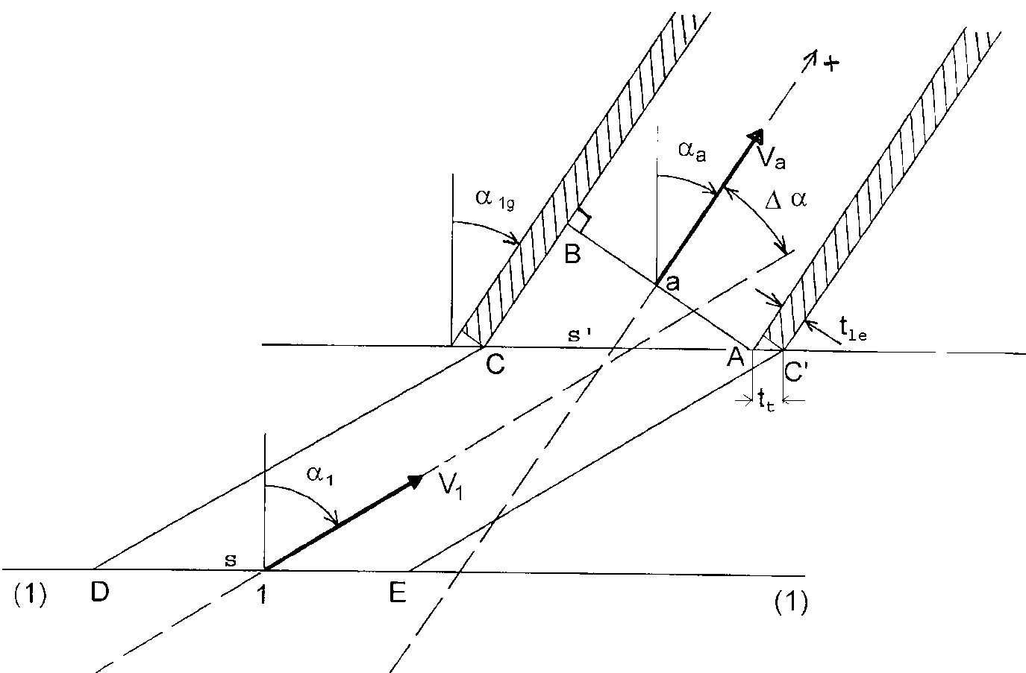
ROTOR
Computed as increase of total enthalpy (work increase) and /or decrease of efficiency → Lu = L_{is} + ∑ Δh _{t,i} ; η = L_{is}/Lu - Δη
Incidence losses
When the blade loading ot the blade leading edge in >0 → | V_{t,1} - V_{t,a} | > 0
Optimum when: by continuity eq. (ρ=cost):
and W_{t,1}=W_{t,a} , →
In design, we choose the geometrical angle to have a β₁ =β_{1,opt}
It is lost the kinetic energy perpendicular to the blade:
For rotors: same concept but V → W and α → β
Tip clearance losses
b = smallest blade height;
ε = clearance

Slide 6
ROTOR
Diffusion and blade loading losses:
Friction losses inside the blade channel:
Formally equals to the duct ones:
L, D = hydraulic lenght and mean diameter c_{f} = c_{f,Moody} + 0.0015

Slide 7
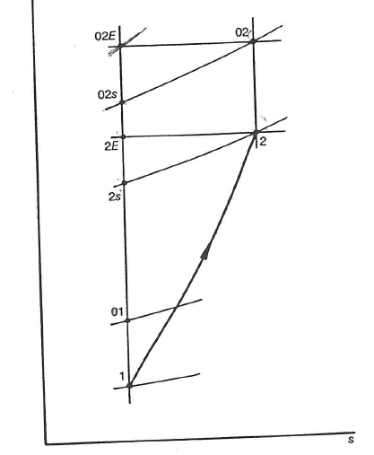
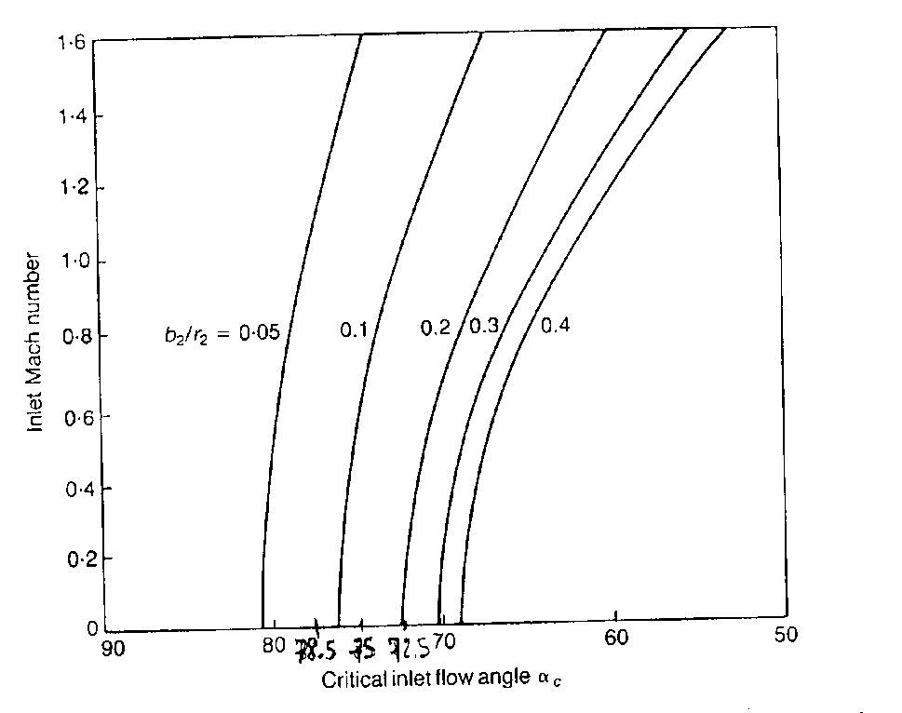
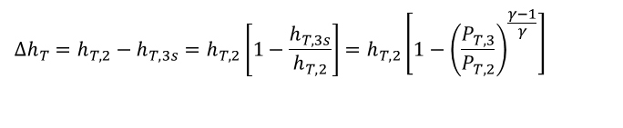
Vaneless diffuser
link V_{3t} ; V_{2t}:
Chosen: D₃/D₂ = 1.2 ; b₃/b₂ = 1
c_{f} = k ( 1.8 *10⁵ / Re ) where k = 0.005 – 0.02
$$Δh_{T}=h_{T,2}−h_{T,3s}=h_{T,2}\left[1−\frac{h_{T,3s}}{h_{T,2}}\right]=h_{T,2}\left[1−{\left(\frac{P_{T,3}}{P_{T,2}}\right)}^{\frac{γ−1}{γ}}\right]$$
stability
h
T,2e
PT,2
T,3
P_{T},3
T,3s

Slide 8
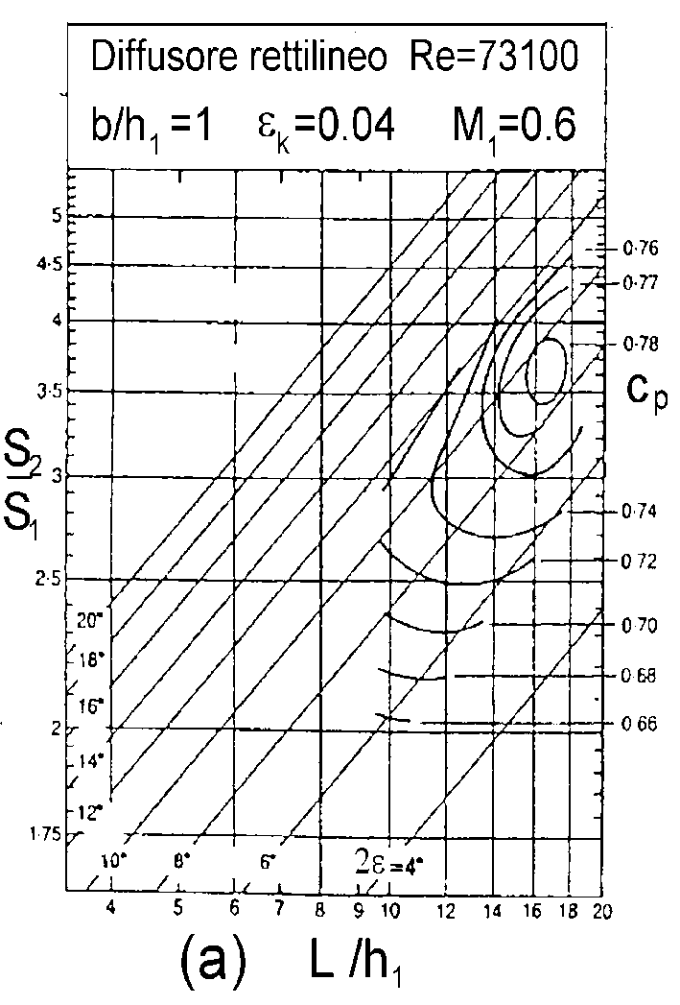
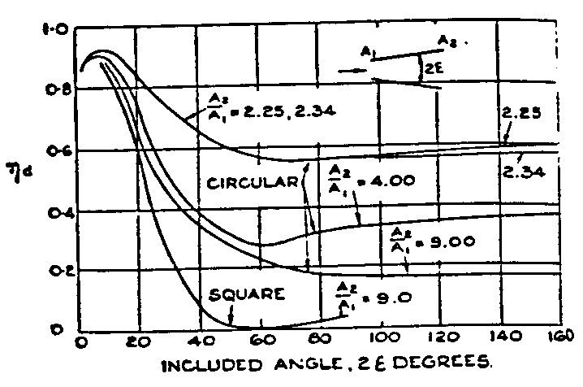
Vaned diffuser
Planar diffuser
Figure 1: efficiency for different diffusers

Slide 9
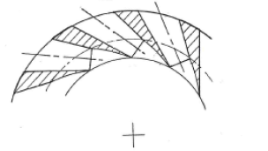







$$L$$
$$H_{4}$$
$$α_{4}$$
$$α_{3}$$
$$H_{3}$$
$$r_{4}$$
$$r_{3}$$

